Slide 1
MGB1121/ CGB1122/EGB1121 – DATA STRUCTURES PROJECT REVIEW-2
Academic Year: 2025 – 2026 (Even Semester)
Register Number :927625BSC001,927625BCS138,927625BCS180
Section Roll Number :A601,A649,A662
Name :AJAY S, SABARISHWARAN P, VIMAL S
Year : I
Semester : II
Section : A6
Date : 22-04-2026

Slide 2
Project Title
WATER FLOW STIMULATION IN PIPES

Slide 3
ABSTRACT
The project presents the design and development of a Simulation of Water Flow in Pipes using Data Structures, focusing on efficient flow analysis and visualization through graph-based techniques. A Graph data structure is used to represent the pipe network, where nodes denote junctions and edges denote pipes. The system follows a role-based approach, where administrators manage the pipe network by adding or deleting connections, while users can run simulations between selected nodes. Dijkstra’s Algorithm is implemented to determine the shortest time path for water flow between nodes. The simulation calculates flow time using parameters such as pipe length and velocity, and visually represents the movement of water through animated interfaces. The system includes a role-based authentication mechanism to ensure secure access and controlled modifications. Additionally, the application integrates real-life use cases such as water supply systems and irrigation. By combining data structures, algorithms, and interactive visualization, the project demonstrates the real-world applicability of computational techniques in fluid flow management systems.

Slide 4
ABSTRACT WITH CO & PO MAPPING
Abstract | CO | PO
The project presents the design and development of a Simulation of Water Flow in Pipes using Data Structures, focusing on efficient flow analysis and visualization through graph-based techniques. A Graph data structure is used to represent the pipe network, where nodes denote junctions and edges denote pipes. The system follows a role-based approach, where administrators manage the pipe network by adding or deleting connections, while users can run simulations between selected nodes. Dijkstra’s Algorithm is implemented to determine the shortest time path for water flow between nodes. The simulation calculates flow time using parameters such as pipe length and velocity, and visually represents the movement of water through animated interfaces. The system includes a role-based authentication mechanism to ensure secure access and controlled modifications. Additionally, the application integrates real-life use cases such as water supply systems and irrigation. By combining data structures, algorithms, and interactive visualization, the project demonstrates the real-world applicability of computational techniques in fluid flow management systems. | CO1 CO2 CO3 CO4 | PO1 PO3 PO4 PO5

Slide 5
INTRODUCTION
The “Water Flow Simulation in Pipes” project is designed to model and analyze the movement of water through a network of interconnected pipes using Data Structures. In real-world systems such as water supply networks, irrigation systems, and drainage systems, understanding the flow path and time is very important.
In this project, a graph-based approach is used where junctions are represented as nodes and pipes are represented as edges. The system calculates the shortest path and minimum time required for water to travel from a source to a destination using Dijkstra’s Algorithm.
In this system, a role-based approach is implemented where only the Admin can modify the pipe network, while Users can only run simulations between nodes. This improves system security and reflects real-world scenarios where only authorized personnel manage infrastructure.”The main aim of this project is to demonstrate how data structures and algorithms can be applied to solve real-world engineering problems efficiently.

Slide 6
DATA STRUCTURES USED
Graph (Adjacency List)
Represents the pipe network
Nodes → Junctions
Edges → Pipes
Priority Queue
Used in Dijkstra’s Algorithm
Helps select the node with minimum distance
Array
Stores distance values and visited status
Queue (Optional for BFS visualization)
Used for flow animation or traversal

Slide 7
ADVANTAGES
Efficient calculation of shortest path
Real-time simulation of water flow
Helps in planning water distribution systems
Reduces manual calculation errors
Scalable for large pipe networks
Easy visualization of complex systems

Slide 8
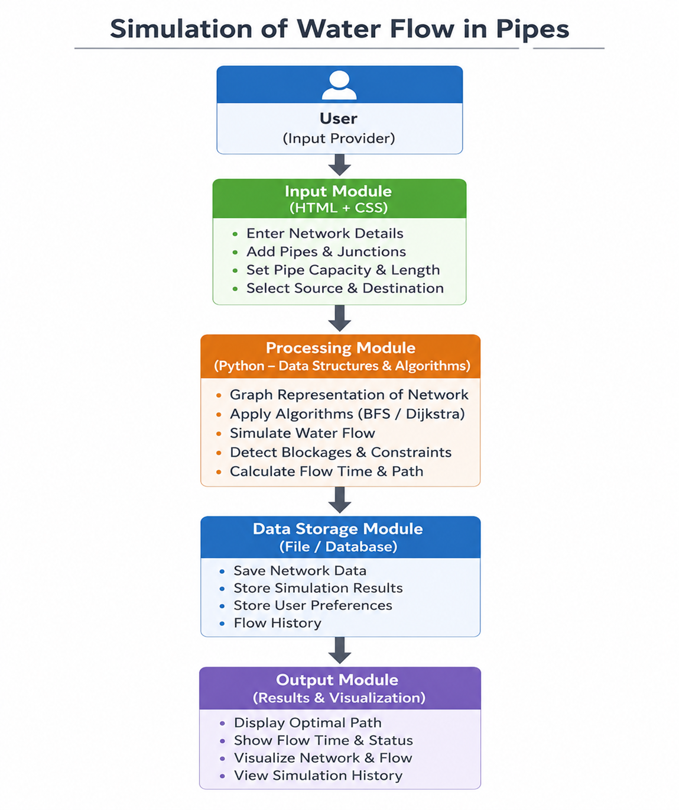
BLOCK DIAGRAM

Slide 9
BLOCK DIAGRAM - DESCRIPTION
The proposed system simulates water flow through a pipeline network using graph-based data structures.
The user enters pipe and junction details through the web interface.
The system creates a graph where nodes represent junctions and edges represent pipes.
Graph algorithms such as BFS and Dijkstra's Algorithm are applied to analyze water flow.
The system calculates the shortest and most efficient path for water distribution.
Flow status, path information, and simulation results are displayed to the user

Slide 10
LIST OF MODULES
Module 1 – User Input Module
Accepts pipe and junction details.
Module 2 – Graph Construction Module
Creates graph representation of the pipeline network.
Module 3 – Flow Simulation Module
Simulates water movement through pipes.
Module 4 – Path Optimization Module
Finds shortest and optimal flow paths using algorithms.
Module 5 – Output & Visualization Module
Displays simulation results and network information

Slide 11
MODULE DESCRIPTION
User Input Module
Collects source and destination nodes.
Accepts pipe length, capacity, and network details.
Graph Construction Module
Represents the pipeline network as a graph.
Nodes represent junctions.
Edges represent water pipes.
Flow Simulation Module
Simulates water flow between connected nodes.
Tracks movement of water through the network.
Identifies possible congestion or blockages.

Slide 12
MODULE DESCRIPTION(CONT…)
Path Optimization Module
Implements BFS for network traversal.
Uses Dijkstra's Algorithm to determine the shortest path.
Calculates minimum flow time between nodes.
Output & Visualization Module
Displays optimal water flow path.
Shows flow distance and travel time.
Presents simulation results in a user-friendly format.
Provides network visualization for analysis

Slide 13
RESULTS AND DISCUSSION
The system successfully calculates the shortest path between nodes
Flow time is accurately computed based on input values
Admin can successfully manage the pipe network (add/delete connections).
Users can independently run simulations between nodes.
Visualization helps users understand flow behavior
Performance is efficient even for larger graphs

Slide 14
RESULTS AND DISCUSSION(CONT…)
Dijkstra’s Algorithm ensures optimal path selection
The system can be extended to real-world applications
Minor limitations include dependency on accurate input data

Slide 15
CONCLUSION
The project demonstrates the effective use of data structures and algorithms in solving real-world problems like water flow management. By using graph representation and Dijkstra’s Algorithm, the system efficiently calculates the shortest path and flow time.
This project can be further enhanced by adding real-time data, pressure calculations, and advanced simulations, making it more suitable for industrial applications.
The role-based system improves security and makes the project more realistic.

Slide 16
REFERENCES
Data Structures by Seymour Lipschutz
Introduction to Algorithms by Thomas H. Cormen
GeeksforGeeks (www.geeksforgeeks.org)
W3Schools (www.w3schools.com)
Research papers on water distribution systems

Slide 17
Thank You!!

